Slide 1
COVID-19 Impact and Analysis in Nigeria: Cases, Recovery Rate, and Mortality Distribution
A Project on Data Science
By
ADUKWU REUBEN

Slide 2
Introduction
The purpose of this presentation is to provide a comprehensive overview of the impact of COVID-19 in Nigeria, with a focus on the distribution of cases, recovery rate, and mortality distribution across different states.
Through the analysis of confirmed cases, discharged cases, and death cases, we aim to shed light on the areas where the virus has had the most significant impact and identify states that have demonstrated effective management and treatment strategies.
By the end of this presentation, we hope to gain a deeper understanding of the COVID-19 situation in Nigeria and highlight the need for continued monitoring, resource allocation, and targeted interventions to combat the virus effectively.

Slide 3
ANALYSIS QUESTION
Exploring the distribution of the virus across each states and the numeric effect on each state. Simply put, the distribution of the confirmed, discharged and the death cases in Nigeria state.
• Explore to get the correlation/relatedness of the features listed above and making inference based on the correlation.
From John Hopkin’s data, getting the active cases in all countries and extracting the out Nigeria out for analysis
Analyze the relation between the confirmed cases, recovery cases and death instance and to use this to compute the infection rate across the country.
Exploring and making inferences from the distribution of the infection rate based on the dates given in the date dataset.

Slide 4
METHODOLOGY
The data used was John Hopkins University (JHU) COVID-19 Data .
Data Cleaning: Preprocess the data to ensure consistency and handle any missing or incorrect values.
Descriptive Analysis: Summarize and visualize the distribution of cases using statistics and graphs.
Correlation Analysis: Explore the relationship between confirmed, discharged, and death cases using correlation coefficients.
All these were done using some python libraries i.e. pandas, matplotlib & seaborn

Slide 5

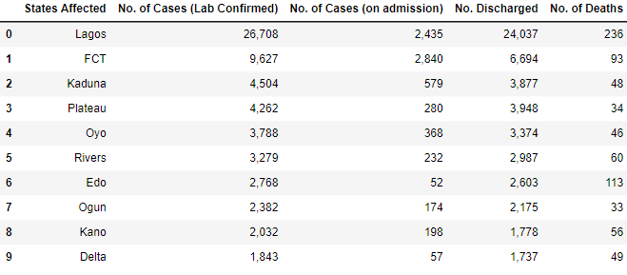
Importing and Reading dataset

Slide 6
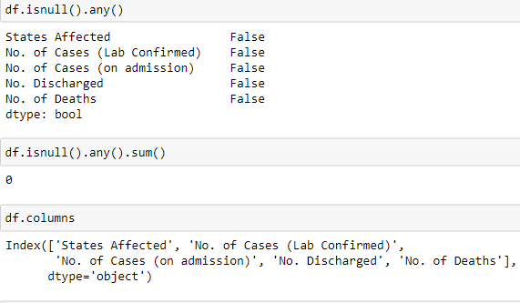
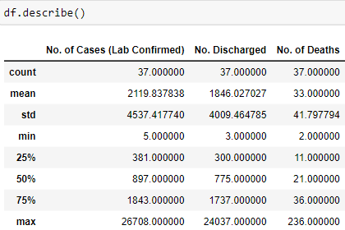
Cleaning Data

Slide 7
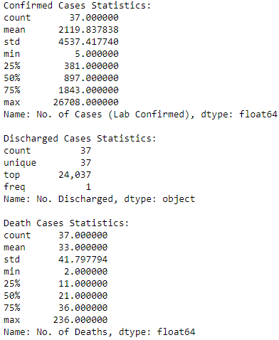
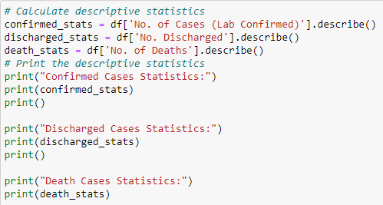

Descriptive Statistic

Slide 8
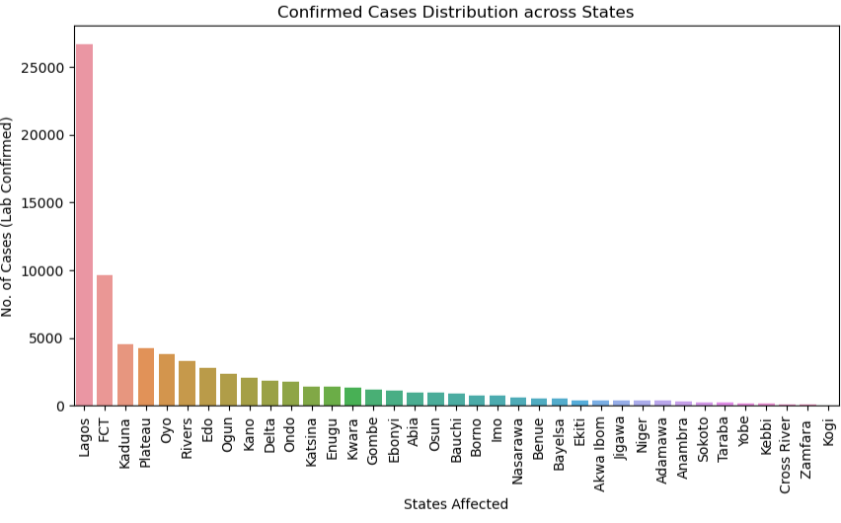
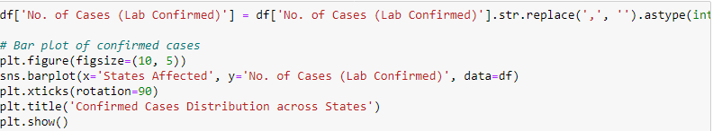
Distribution of Confirmed Cases in Nigerian States

Slide 9
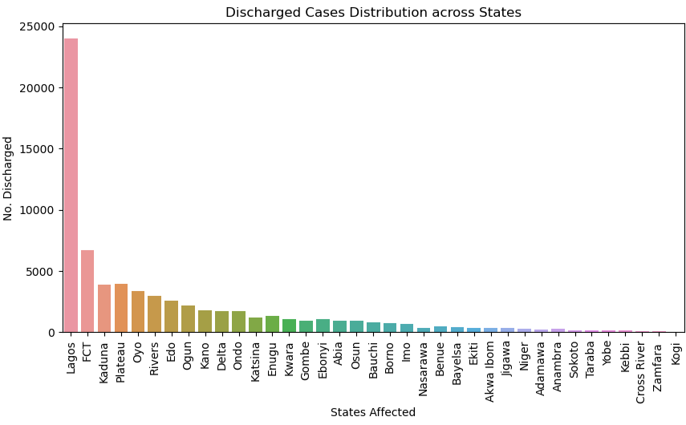
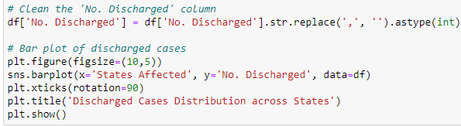
Distribution of Discharged Cases in Nigerian States

Slide 10
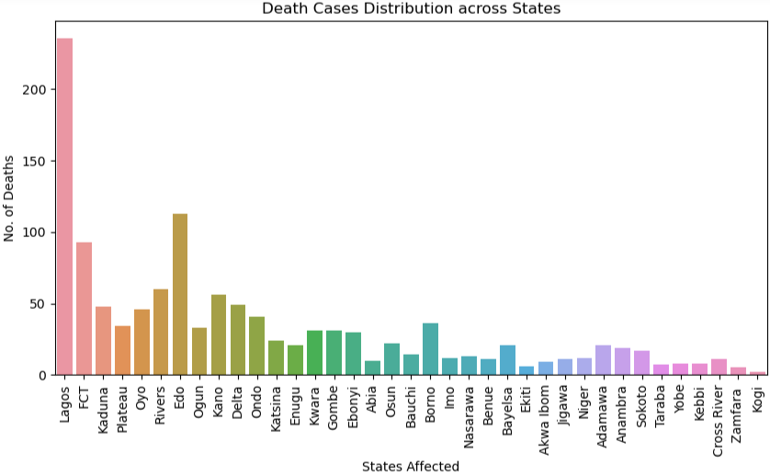
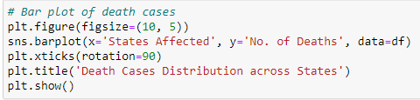
Distribution of Death Cases in Nigerian States

Slide 11
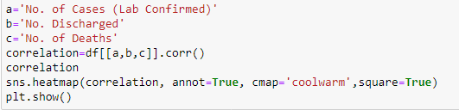
Heatmap Analysis

Slide 12
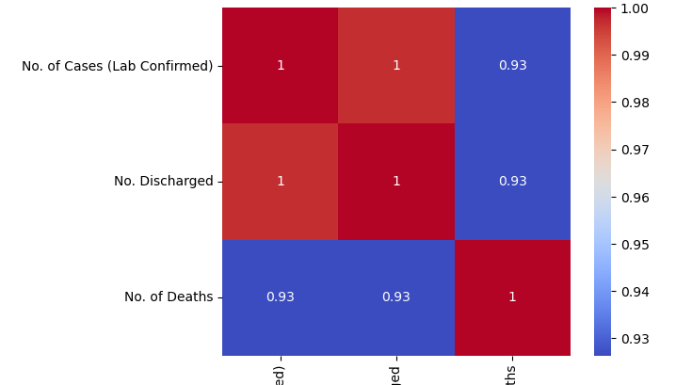
Heatmap

Slide 13
Summary
Lagos is the most affected state in Nigeria, with a high number of confirmed cases, recoveries, and deaths. It requires continued attention and resources to combat the spread of the virus and provide adequate healthcare services.
FCT and Kaduna have significant numbers of confirmed cases but have shown a relatively higher recovery rate, indicating effective management and treatment strategies.
Edo stands out for its relatively high mortality rate, necessitating targeted efforts to reduce fatalities and improve healthcare facilities.
It's important to note that the analysis is based on the available data and is subject to change as new information becomes available.

Slide 14
Conclusion
In conclusion, this study aimed to analyze the distribution of COVID-19 cases in Nigerian states and explore their correlation with recovery and mortality rates. It also examined the impact of the pandemic on the country's economy. Through data analysis, we found that Lagos, FCT, Kaduna, and Edo states require focused attention and targeted interventions due to higher numbers of confirmed cases, deaths, and the need to improve healthcare services.

Slide 15
Acknowledgements
I would like to express my heartfelt gratitude to my tutors for their invaluable contribution to the knowledge impacted, which formed the foundation of this presentation. Their guidance and support have been instrumental in shaping the content and insights presented.

